Slide 2
Build 2019 Update
Nick Ward
Microsoft Australia

Slide 3
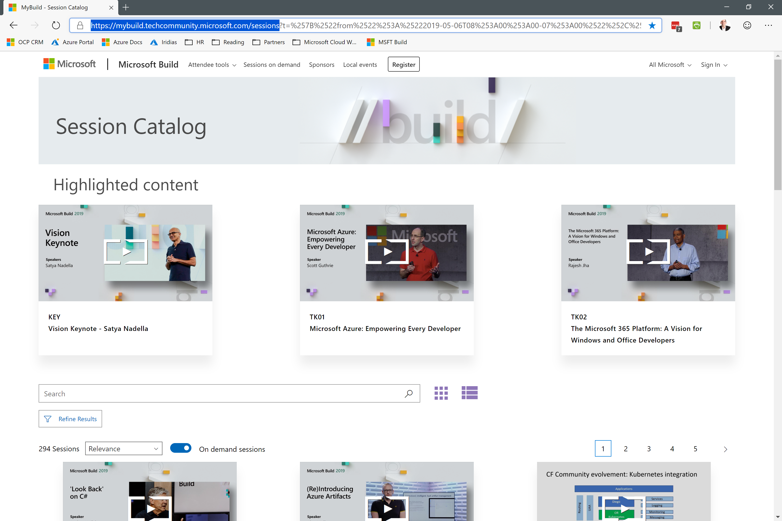
Build 2019
https://mybuild.techcommunity.microsoft.com/sessions

Slide 4
Azure
.NET
Microsoft 365
Windows Terminal

Slide 5
Azure AI: Knowledge Mining
While organizations have seemingly unlimited access to information that can range from PDFs to media files, there are still significant challenges in making that information usable and meaningful. With knowledge mining, you can leverage industry leading AI capabilities to easily unlock latent insights from all your content.
The cognitive search capability of Azure Search, is now generally available and up to 30 times faster than before. Azure Search is the only offering in the market with a single mechanism to apply AI enrichments to content. Using Cognitive Search and its built-in AI capabilities, customers can discover patterns and relationships in their content, understand sentiment, extract key phrases and more, all without any data science expertise.
https://azure.microsoft.com/en-us/blog/making-ai-real-for-every-developer-and-every-organization/

Slide 6
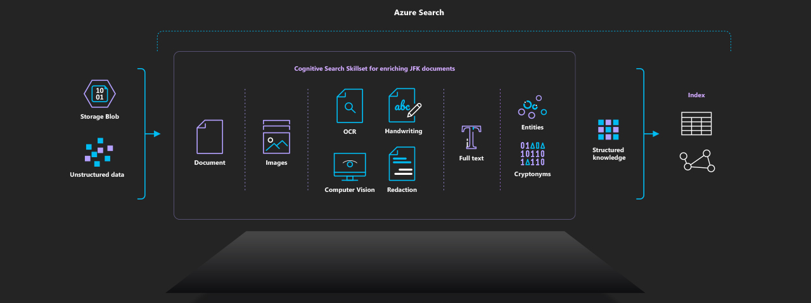
Azure Search Reference Implementation: JFK Files
https://jfk-demo.azurewebsites.net/#/
https://github.com/Microsoft/AzureSearch_JFK_Files

Slide 7
Azure AI: AI Powered Apps and Agents
Azure Cognitive Services continues to be the most comprehensive portfolio in the market for developers who want to embed the ability to see, hear, respond, translate, reason and more into their apps. Today we’re making it even easier for developers to embed AI into their applications.
Introduction of new Decision category for Cognitive Services. Services in this category provide users recommendations to enable informed and efficient decision-making. Services such as Content Moderator, the recently announced Anomaly Detector and the preview of a new service called Personalizer are part of this new category. Personalizer is built on reinforcement-learning and prioritizes relevant content and experiences for each user.
In Vision, we are announcing the preview of two new services. Ink Recognizer enables developers to combine the benefits of physical pen and paper with the best of the digital by embedding digital ink recognition capabilities into apps. Form Recognizer automates data entry by extracting text, key-value pairs and tables from documents.
In Speech, we are announcing preview of new advanced speech-to-text capability called conversation transcription that catalyzes meeting efficiency by transcribing conversations in real-time so participants can fully engage in the discussion, know who said what when, and quickly follow up on next steps.
https://azure.microsoft.com/en-us/blog/making-ai-real-for-every-developer-and-every-organization/

Slide 8
Azure AI: Azure Machine
New Azure Machine Learning service capabilities that will enable developers, data scientist and DevOps professional across all skill levels to be even more productive, operationalize models at scale and innovate faster using an open platform.
Simplifying machine learning for all skill levels: Preview of new automated machine learning UX, drag and drop machine learning and integrated notebooks for code first experience.
Built for enterprises: New MLOps capabilities to simplify end-to-end lifecycle from data preparation to deployment and monitoring with Azure DevOps integration.
Open & Interoperable: Native integration with MLFlow. ONNX Runtime integration with leading hardware accelerators (details below).
https://azure.microsoft.com/en-us/blog/making-ai-real-for-every-developer-and-every-organization/

Slide 9
Azure Blockchain Service
Today, we are excited to announce the public preview of Azure Blockchain Service, a fully-managed blockchain service, which simplifies the formation, management, and governance of consortium blockchain networks so businesses can focus on workflow logic and application development. With a few simple clicks, users can create and deploy a permissioned blockchain network and manage consortium policies using an intuitive interface in the Azure Portal.
This week, we’re also thrilled to announce a partnership with J.P. Morgan to make Quorum the first ledger available in Azure Blockchain Service. Quorum is built on the popular Ethereum protocol, which has world’s largest blockchain developer community. Quorum therefore integrates with a rich set of open source tools while also supporting confidential transactions, something our enterprise customers require. With Azure Blockchain Service, Quorum customers like Starbucks, LVMH and our own Xbox Finance team can now quickly expand their networks with lower costs, shifting their focus from infrastructure to application and business process.
Azure Blockchain Service is just the beginning though. In the past, codifying your logic using smart contracts has been a labor-intensive process. Today we are releasing an extension for VS Code so that you can create and compile Ethereum smart contracts, deploy them to either the public chain or a consortium network in Azure Blockchain Service and manage their code using Azure DevOps, all from within VS Code.
Cloud for all means cloud for all. Instead of building our own ledger, or creating a ledger alternative, we have worked to make open source technologies developers love work better with Azure. All of the tooling released this week allows developers to work against consortium networks in Azure Blockchain Service and with public Ethereum.
Read more: https://azure.microsoft.com/en-us/blog/digitizing-trust-azure-blockchain-service-simplifies-blockchain-development/

Slide 10
Intelligent Edge: When smart computing gets smarter
The virtually limitless computing power of the cloud, combined with increasingly intelligent and perceptive devices at the edge of the network, create possibilities we could only have dreamed of just a few years ago. Infinite amounts of data, millions of connected devices, limitless possibilities. We believe the intelligent edge, with the power of the intelligent cloud, will transform the way we will interact with digital information and further blend the physical and digital worlds for greater societal benefit and customer innovation.
Today, we are excited to announce a limited preview of Azure SQL Database Edge, which brings the same performant, secure and easy to manage SQL engine that our customers love in Azure SQL Database and SQL Server on premises to the edge.
When the intelligent cloud and intelligent edge are imbued with mixed reality and artificial intelligence, we have a framework for achieving amazing things and empowering even more people. To further those achievements, we are expanding our Mixed Reality Developer Program to serve the more than 20,000 mixed reality developers we’ve engaged with in the past year. A number we expect to triple over the next year. Because of this rapidly growing community, we are expanding the program to educate and build the MR developers of the future. To support developers in their MR journey, we’re excited to announce the HoloLens 2 Development Edition. Available through the Mixed Reality Developer Program, the Development Edition brings together all the tools developers needed to get started:
HoloLens 2 mixed reality device
$500.00 in Azure credits – To jump start your MR development using Azure mixed reality services
3-month free trials of Unity Pro and the Unity PiXYZ Plugin for CAD data
IoT Plug and Play is here. No longer will the hurdles of form-factors, processing capabilities, operational systems, or memory prohibit the connectivity of devices. IoT Plug and Play offers a new, open modeling language to connect IoT devices to the cloud seamlessly. With IoT Plug and Play, developers can connect IoT devices to the cloud, without having to write a single line of embedded code. IoT Plug and Play also enables device manufactures to build smarter IoT devices that just work with the cloud.
https://azure.microsoft.com/en-us/blog/intelligent-edge-innovation-across-data-iot-and-mixed-reality/

Slide 11
Azure Database Hyperscale & Serverless
Today, we are excited to deliver a high-performance scaling capability for applications using the relational model Hyperscale, further removing limits for application developers. Hyperscale is a new cloud-native solution that is built to deliver high performance and scale to your relational database workloads, without rearchitecting your application.
Azure Database for PostgreSQL Hyperscale (Citus) – now in Public Preview, brings high-performance scaling to PostgreSQL database workloads by horizontally scaling a single database across hundreds of nodes to deliver blazingly fast performance and scale. With horizontal scale-out, you can fit more data in-memory, parallelize queries across hundreds of nodes, and index data faster. The addition of Hyperscale (Citus) as a deployment option for Azure Database for PostgreSQL simplifies your infrastructure and application design, saving organizations time to focus on their business needs.
Azure SQL Database Hyperscale – now Generally Available, is powered by a highly scalable storage architecture that enables a database to grow as needed, with support for up to 100TB, effectively eliminating the need to pre-provision storage resources. Businesses can scale compute and storage resources independently, giving them the flexibility to optimize performance for their workloads. Azure SQL Database Hyperscale is not the only SQL innovation we are announcing today, Azure SQL Database is also introducing a new serverless compute option. With SQL Database Serverless, compute and memory scale independently based on the workload requirements, and compute is automatically paused and resumed, freeing customers from the requirements of managing capacity and helping them save money.
https://azure.microsoft.com/en-us/blog/get-high-performance-scaling-for-your-azure-database-workloads-with-hyperscale/

Slide 12
Serverless Kubernetes: Simplifying for the Enterprise
As we approach the fifth anniversary of the open sourcing of the Kubernetes project, it’s remarkable to look back and the way in which this project has transformed cloud and distributed systems. But the truth is, as much impact that Kubernetes and containers have had over the past five years, there are other cloud transformations that have been equally important. One of the most significant of these has been the growth of serverless computing and what it’s opened the door to.
Virtual Nodes in the Azure Kubernetes Service is our serverless container offering for Kubernetes. Virtual nodes allow users to rapidly scale their applications using cloud-based serverless containers that run directly on Azure’s cloud infrastructure. Not only are these containers fast to start, but they provide serverless container infrastructure with the simplicity of IaaS, without the complexity of virtual machines. With no virtual machine infrastructure to manage, patch, update or worry about, virtual nodes enable users to focus even more of their attention on applications and not managing infrastructure.
Kubernetes-based event-driven autoscaling is a new open-source project that supports deployment of serverless, event-driven containers on any Kubernetes environment, including Red Hat OpenShift, be it on on-premises, public or private cloud.
https://azure.microsoft.com/en-us/blog/partnering-with-the-community-to-make-kubernetes-easier/

Slide 13
DevOps: Building Better Apps, Faster
Building better apps, faster, is a key enabler of digital transformation for every company. Many businesses are facing external pressures to become more agile, and this in turn is putting more demands on development and operations teams to build digital solutions benefitting the company and their customers. This is where DevOps practices, starting from agile development methodologies, can help. To help enterprises there are two core solutions that are enablers of DevOps practices - Azure DevOps and GitHub.
Azure DevOps - To help developers deliver apps faster and more consistently, Azure DevOps brings the capability to plan, build and ship applications that are written in any language, on any platform. Azure Pipelines, a core part of Azure DevOps, allows for the creation of Build pipelines (Continuous Integration) in a declarative way using YAML documents. Now, we’re excited to announce that development teams can leverage the same YAML documents to build multi-stage pipelines-as-code for both Build and Release pipelines (Continuous Integration and Continuous Delivery). This was one of the biggest requests from our customers. Adding the ability to create deployment pipelines with YAML files and store them in source control helps to drive a tighter feedback loop between development and operation teams, relying on clear, human-readable documents.
GitHub - It’s been a little less than a year since Microsoft acquired GitHub, the largest developer community on the planet. Enabling developers to deliver faster and meet the needs of the enterprise continues to be a major area of focus. Today, we’re excited to announce that GitHub Enterprise now supports Azure Active Directory. This integration enables customers to leverage their existing Azure Active Directory solution for group membership in GitHub, reducing administration time, improving auditability, and increasing security.
https://azure.microsoft.com/en-us/blog/accelerating-devops-with-github-and-azure/

Slide 14
Analytics in Azure
When it comes to analytics, customers tell us that they need a solution that provides them with the best price, performance, security and privacy, as well as a system that can easily deliver powerful insights across the organization. Today we’re excited to announce new capabilities in both Azure Data Factory and Azure SQL Data Warehouse that further strengthen analytics and time to insights.
Azure Data Factory is a hybrid data integration service for developing scalable extract/transform/load and extract/load/transform (ETL/ELT) data pipelines. With Data Factory, cloud-scale data integration can now be done through an intuitive visual environment and with no code, reducing data silos.
Azure Data Factory now features visual data transformation with Mapping Data Flows in public preview. With a few clicks, users can focus on building their data models rather than writing and maintaining code. Mapping Data Flows is powered by Azure Databricks and provides the same processing power and scale as the code-based approach directly in Azure Databricks.
In addition to Mapping Data Flows, we are further extending the capabilities in Data Factory to enable code-free data preparation at scale with Wrangling Data Flows, in limited private preview. Wrangling Data Flows empowers users to visually discover and explore their data without writing code.
We are also excited to announce today Azure SQL Data Warehouse’s support for semi-structured data. Now with one service, both structured and semi-structured data formats (like JSON) can now be analyzed directly from the data warehouse for faster insights.
https://azure.microsoft.com/en-us/blog/analytics-in-azure-remains-unmatched-with-new-innovations/

Slide 15
Power Platform and Azure enable developers to build apps faster than ever before
The Power Platform is composed of Power BI, PowerApps and Microsoft Flow. It includes the Common Data Service—an enterprise-grade datastore, and access to a wide variety of connectors. Bolstering all of this is its native integration with the Azure ecosystem. Today, we are announcing three areas of updates and investment for the Power Platform.
Boosting productivity for pro developers: Professional developers can now build responsive, reusable components using our new PowerApps Component Framework (PCF). Components can be build using our new PCF command line interface offering a complete JavaScript or TypeScript developer experience. Also, developers can now automatically and easily connect to Azure resources from inside of PowerApps and Microsoft Flow.
Rich application lifecycle management: solution support for canvas apps and flows, enable continuous integration and deployment of PowerApps projects. Additionally, the new Power Platform Checkers make it possible to build high quality apps faster than ever before.
A low-code approach to blockchain with Power Platform: Low-code blockchain development is here, enabling anyone to become a blockchain developer. Our new Smart Contract templates and connectors to blockchain databases can help to get started easily.
https://cloudblogs.microsoft.com/dynamics365/bdm/2019/05/06/power-platform-azure-enable-developers-to-build-apps-faster-than-ever/

Slide 16
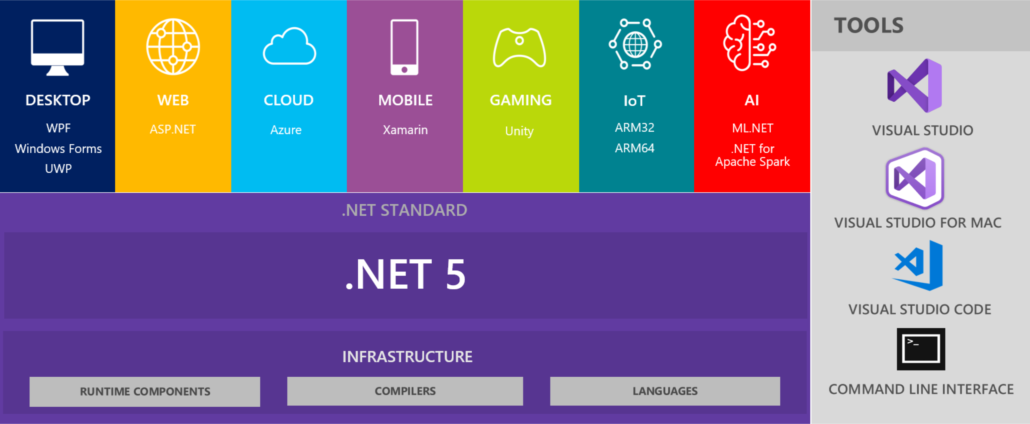
.NET 5
https://devblogs.microsoft.com/dotnet/introducing-net-5/

Slide 17
The Microsoft 365 Platform
Microsoft Identity
Microsoft Graph
Microsoft Windows
Microsoft Edge
Microsoft Teams
Microsoft Office & SharePoint

Slide 18
Microsoft 365 at Build 2019
https://developer.microsoft.com/en-us/graph/blogs/microsoft-365-at-build-2019-the-guide/
https://www.microsoft.com/en-us/microsoft-365/blog/2019/05/06/build-2019-people-centered-experiences-microsoft-365-productivity-cloud/

Slide 19
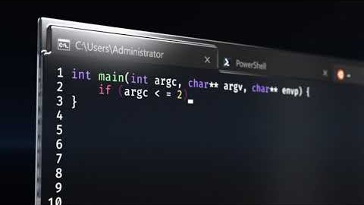

Slide 20
Windows Terminal
Microsoft Windows Terminal, GitHub repo
Windows Terminal Build 2019 FAQ (including links to relevant build sessions)
Building the new Windows Terminal with Visual Studio 2019, Donovan Brown’s blog
A New Console For Windows, Scott Hanselman’s blog
An Experiment – The Azure Cloud Shell at the command line with AZ SHELL, Scott Hanselman’s blog
azshell experimental console, GitHub repo

Slide 21
And finally… https://news.microsoft.com/wp-content/uploads/prod/sites/558/2019/05/FINAL-Book-of-News-Build-2019.pdf

